Slide 1
스토커 : STOCKER
IT Seminar
201310902 문성환
201315298 정성민

Slide 2



프로젝트 소개
프로그램 설계
프로젝트 시연

Slide 3


프로젝트 소개 | 프로그램 설계 | 프로젝트 시연
STOCKER ?
주식 시장 웹페이지를 크롤링해 뉴스정보를 얻어온다.
뉴스정보를 분석해 주식 시장의 분위기를 분석한다.
분석된 결과를 토대로 그래프나 차트를 통해 투자자의 결정을 보조한다.

Slide 4
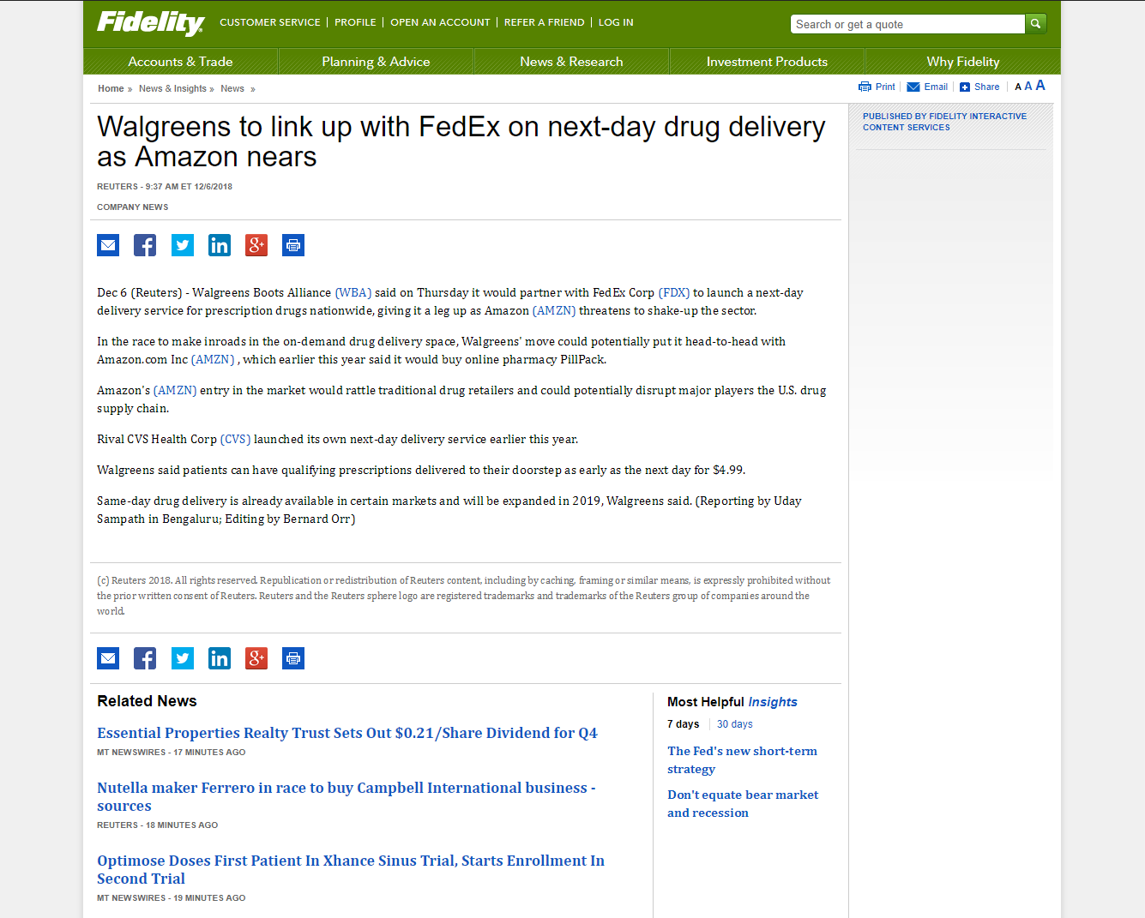
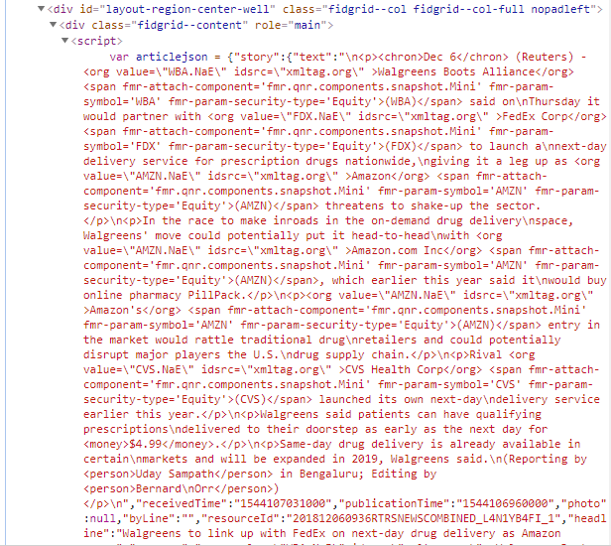
프로젝트 소개 | 프로그램 설계 | 프로젝트 시연
웹 페이지 크롤링
Python 3 의 HTMLParser 를 이용한 Fidelity.com 정보 추출

Slide 5
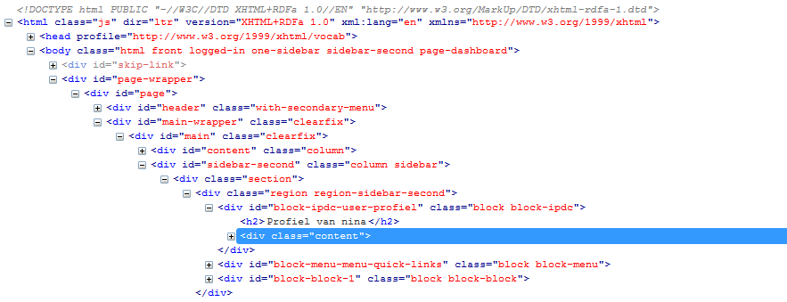
프로젝트 소개 | 프로그램 설계 | 프로젝트 시연
웹 페이지 크롤링
전반적 HTML Source 구조
<div class=“…”>
….
<div id=“…”>
….
<script src=“…”>
….
</script>
</div>
</div>

Slide 6
프로젝트 소개 | 프로그램 설계 | 프로젝트 시연
웹 페이지 크롤링
Python 3 의 HTMLParser 를 이용한 Fidelity.com 정보 추출
def handle_starttag(self, tag, attrs):
def handle_endtag(self, tag):
def handle_data(self, data):

Slide 7

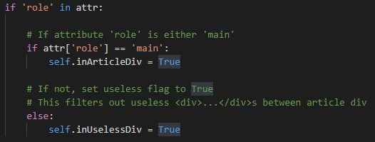
프로젝트 소개 | 프로그램 설계 | 프로젝트 시연
웹 페이지 크롤링
Python 3 의 HTMLParser 를 이용한 Fidelity.com 정보 추출
def handle_starttag(self, tag, attrs):

Slide 8
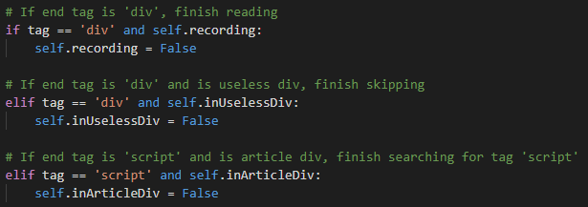
프로젝트 소개 | 프로그램 설계 | 프로젝트 시연
웹 페이지 크롤링
Python 3 의 HTMLParser 를 이용한 Fidelity.com 정보 추출
def handle_endtag(self, tag):

Slide 9

프로젝트 소개 | 프로그램 설계 | 프로젝트 시연
웹 페이지 크롤링
Python 3 의 HTMLParser 를 이용한 Fidelity.com 정보 추출
var articlejson = {"story":{"text":"\n<p><chron>Dec 6</chron> (Reuters) - <org value=\"WBA.NaE\" idsrc=\"xmltag.org\" >Walgreens Boots Alliance</org> <span fmr-attach-component='fmr.qnr.components.snapshot.Mini' fmr-param-symbol='WBA' fmr-param-security-type='Equity'>(WBA)</span> said on\nThursday it would partner with <org value=\"FDX.NaE\" idsrc=\"xmltag.org\" >FedEx Corp</org> <span fmr-attach-component='fmr.qnr.components.snapshot.Mini' fmr-param-symbol='FDX' fmr-param-security-type='Equity'>(FDX)</span> to launch a\nnext-day delivery service for prescription drugs nationwide,\ngiving it a leg up as <org value=\"AMZN.NaE\" idsrc=\"xmltag.org\" >Amazon</org> <span fmr-attach-component='fmr.qnr.components.snapshot.Mini' fmr-param-symbol='AMZN' fmr-param-security-type='Equity'>(AMZN)</span> threatens to shake-up the sector.</p>\n<p>In the race to make inroads in the on-demand drug delivery\nspace, Walgreens' move could potentially put it head-to-head\nwith <org value=\"AMZN.NaE\" idsrc=\"xmltag.org\" >Amazon.com Inc</org> <span fmr-attach-component='fmr.qnr.components.snapshot.Mini' fmr-param-symbol='AMZN' fmr-param-security-type='Equity'>(AMZN)</span>, which earlier this year said it\nwould buy online pharmacy PillPack.</p>\n<p><org value=\"AMZN.NaE\" idsrc=\"xmltag.org\" >Amazon's</org> <span fmr-attach-component='fmr.qnr.components.snapshot.Mini' fmr-param-symbol='AMZN' fmr-param-security-type='Equity'>(AMZN)</span> entry in the market would rattle traditional drug\nretailers and could potentially disrupt major players the U.S.\ndrug supply chain.</p>\n<p>Rival <org value=\"CVS.NaE\" idsrc=\"xmltag.org\" >CVS Health Corp</org> <span fmr-attach-component='fmr.qnr.components.snapshot.Mini' fmr-param-symbol='CVS' fmr-param-security-type='Equity'>(CVS)</span> launched its own next-day\ndelivery service earlier this…………..
def handle_data(self, data):

Slide 10
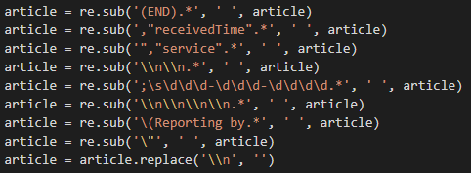
프로젝트 소개 | 프로그램 설계 | 프로젝트 시연
웹 페이지 크롤링
Python 3 의 HTMLParser 를 이용한 Fidelity.com 정보 추출
필요한 정보만 Regular Expression 을 이용해 정리
Dec 6 (Reuters) - Walgreens Boots Alliance (WBA) said onThursday it would partner with FedEx Corp (FDX) to launch anext-day
delivery service for prescription drugs nationwide,giving it a leg up as Amazon (AMZN) threatens to shake-up the sector.In the race to make inroads in the on-demand drug deliveryspace, Walgreens' move could potentially put it head-to-headwith Amazon.com Inc (AMZN), which earlier this year said itwould buy online pharmacy PillPack.Amazon's (AMZN) entry in the market would rattle traditional drugretailers and could potentially disrupt major players the U.S.drug supply chain.Rival CVS Health Corp (CVS) launched its own next-daydelivery service earlier this year.Walgreens said patients can have qualifying prescriptionsdelivered to their doorstep as early as the next day for $4.99.Same-day drug delivery is already available in certainmarkets and will be expanded in 2019, Walgreens said.

Slide 11

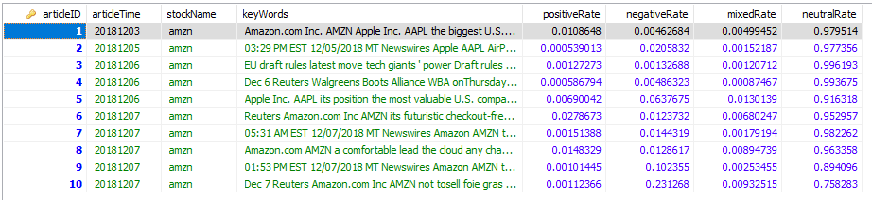
프로젝트 소개 | 프로그램 설계 | 프로젝트 시연
뉴스 데이터 분석
AWS Comprehend 를 이용한 텍스트 분석
Dec 6 (Reuters) - Walgreens Boots Alliance (WBA) said onThursday it would partner with FedEx Corp (FDX) to launch anext-day
delivery service for prescription drugs nationwide,giving it a leg up as Amazon (AMZN) threatens to shake-up the sector.In the race to make inroads in the on-demand drug deliveryspace, Walgreens' move could potentially put it head-to-headwith Amazon.com Inc (AMZN), which earlier this year said itwould buy online pharmacy PillPack.Amazon's (AMZN) entry in the market would rattle traditional drugretailers and could potentially disrupt major players the U.S.drug supply chain.Rival CVS Health Corp (CVS) launched its own next-daydelivery service earlier this year.Walgreens said patients can have qualifying prescriptionsdelivered to their doorstep as early as the next day for $4.99.Same-day drug delivery is already available in certainmarkets and will be expanded in 2019, Walgreens said.

Slide 12
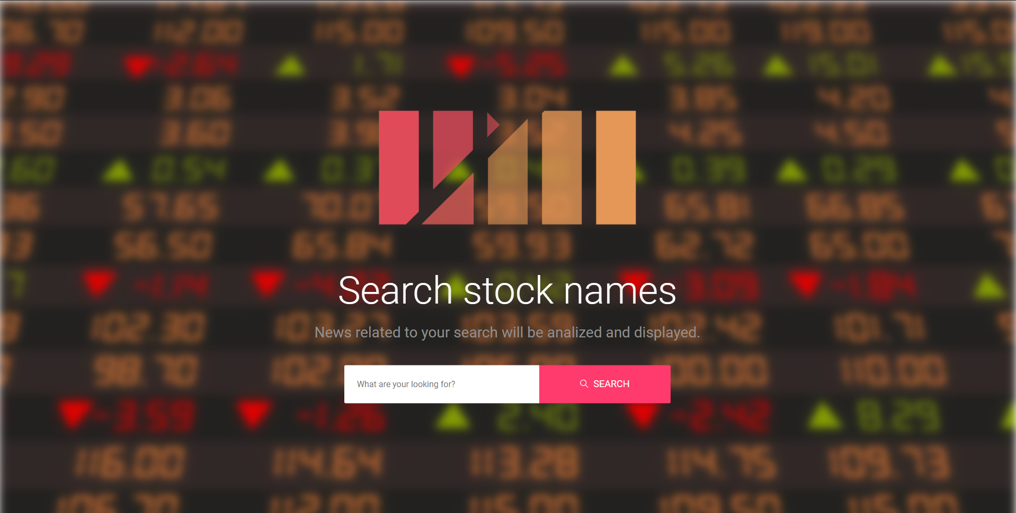
프로젝트 소개 | 프로그램 설계 | 프로젝트 시연
http://210.117.181.240:8080/Webpage/index.html

Slide 13
THANK YOU

